Slide 1
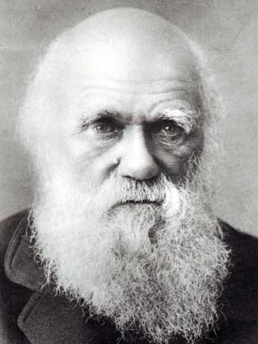
Genetic Algorithms
“Genetic Algorithms are good at taking large, potentially huge search spaces and navigating them, looking for optimal combinations of things, solutions you might not otherwise find in a lifetime.”
- Salvatore Mangano
Computer Design, May 1995
Darwin

Slide 2
The Genetic Algorithm
Directed search algorithms based on the mechanics of biological evolution
Developed by John Holland, University of Michigan (1970’s)
  To understand the adaptive processes of natural systems
  To design artificial systems software that retains the robustness of natural systems
Some of these sides are based on those from Wendy Williams

Slide 3
The Genetic Algorithm (cont.)
Provide efficient, effective techniques for optimization and machine learning applications
Widely-used today in business, scientific and engineering circles

Slide 4
Definition of the genetic algorithm (GA)
The genetic algorithm is a probabalistic search algorithm that iteratively transforms a set (called a population) of mathematical objects (typically fixed-length binary character strings), each with an associated fitness value, into a new population of offspring objects using the Darwinian principle of natural selection and using operations that are patterned after naturally occurring genetic operations, such as crossover (sexual recombination) and mutation.
John R. Koza

Slide 5
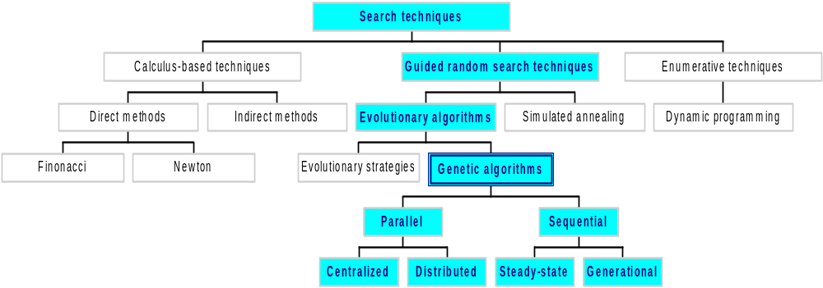
Classes of Search Techniques

Slide 6
Components of a GA
A problem to solve, and ...
Encoding technique (gene, chromosome)
Initialization procedure (creation)
Evaluation function (environment)
Selection of parents (reproduction)
Genetic operators (mutation, recombination)
Parameter settings (practice and art)

Slide 7
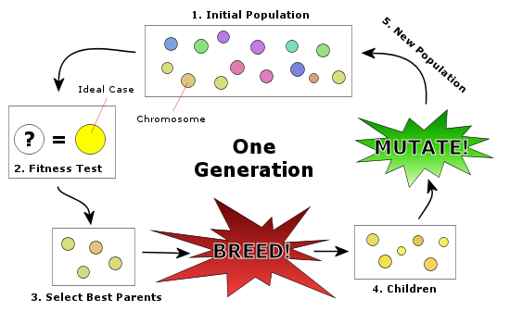
How GA Works

Slide 8
Simple Genetic Algorithm
{
  initialize population;
  evaluate population;
  while TerminationCriteriaNotSatisfied
  {
    select parents for reproduction;
    perform recombination and mutation;
    evaluate population;
  }
}

Slide 9
The GA Cycle of Reproduction
children
reproduction
modification
modified
children
parents
population
evaluation
evaluated children
deleted
members
discard

Slide 10
Population
population
Chromosomes could be:
  Bit strings (0101 ... 1100)
  Real numbers (43.2 -33.1 ... 0.0 89.2)
  Permutations of element (E11 E3 E7 ... E1 E15)
  Lists of rules (R1 R2 R3 ... R22 R23)
  Program elements (genetic programming)
  ... any data structure ...

Slide 11
Reproduction
children
reproduction
parents
population
Parents are selected at random with selection chances biased in relation to chromosome evaluations.

Slide 12
Chromosome Modification
Modifications are stochastically triggered
Operator types are:
  Mutation
  Crossover (recombination)
children
modification
modified children

Slide 13
Parent Selection
Roulette wheel
Tournament

Slide 14
Mutation: Local Modification
Before: (1 0 1 1 0 1 1 0)
After: (0 1 1 0 0 1 1 0)
Before: (1.38 -69.4 326.44 0.1)
After: (1.38 -67.5 326.44 0.1)
Causes movement in the search space
(local or global)
Restores lost information to the population

Slide 15
Crossover: Recombination
*
P1 (0 1 1 0 1 0 0 0) (0 1 0 0 1 0 0 0) C1
P2 (1 1 0 1 1 0 1 0) (1 1 1 1 1 0 1 0) C2
Crossover is a critical feature of genetic
algorithms:
  It greatly accelerates search early in evolution of a population
  It leads to effective combination of schemata (subsolutions on different chromosomes)

Slide 16
Evaluation
The evaluator decodes a chromosome and assigns it a fitness measure
The evaluator is the only link between a classical GA and the problem it is solving
modified
children
evaluated
children
evaluation
Notes:
Fitness function of travelling salesman problem: the distance travelled.

Slide 17
Deletion
population
Generational GA:
entire populations replaced with each iteration
Steady-state GA:
a few members replaced each generation
discarded members
discard
Notes:
Greedy algorithm: choose the best for each step, might be the fastest solution.

Slide 18
An Abstract Example
Distribution of Individuals in Generation 0
Most of the points are towards the top after algorithm
Distribution of Individuals in Generation N

Slide 19
A Simple Example
The Traveling Salesman Problem:
Find a tour of a given set of cities so that
  each city is visited only once
  the total distance traveled is minimized

Slide 20
Representation
Representation is an ordered list of city
numbers known as an order-based GA.
1) London 3) Dunedin 5) Beijing 7) Tokyo
2) Venice 4) Singapore 6) Phoenix 8) Victoria
CityList1 (3 5 7 2 1 6 4 8)
CityList2 (2 5 7 6 8 1 3 4)

Slide 21
Crossover
Crossover combines inversion and
recombination:
* *
Parent1 (3 5 7 2 1 6 4 8)
Parent2 (2 5 7 6 8 1 3 4)
Child (5 8 7 2 1 6 3 4)
This operator is called the Order1 crossover.

Slide 22
Mutation
Mutation involves reordering of the list:
* *
Before: (5 8 7 2 1 6 3 4)
After: (5 8 6 2 1 7 3 4)

Slide 23
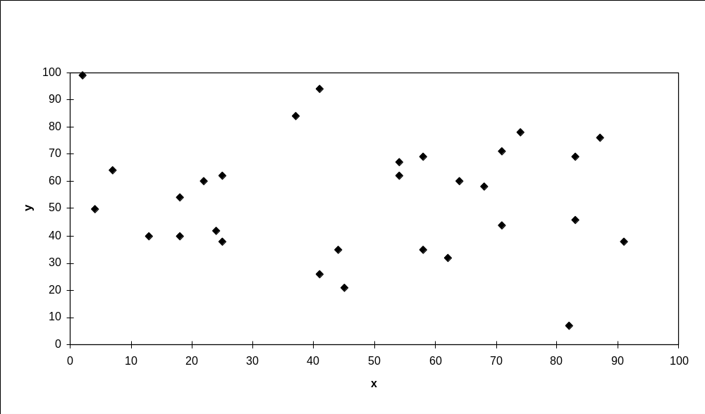
TSP Example: 30 Cities

Slide 24
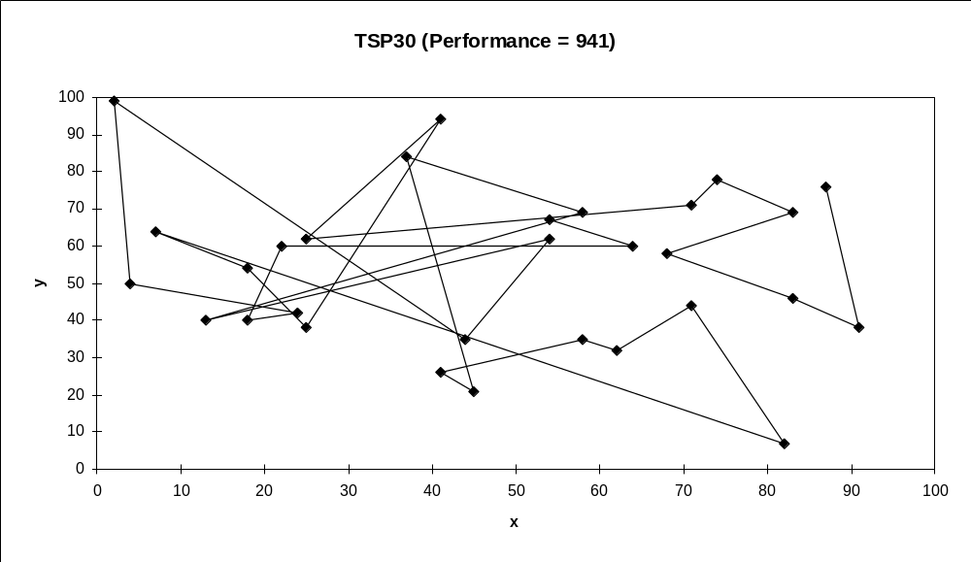
Solution _{i} (Distance = 941)

Slide 25
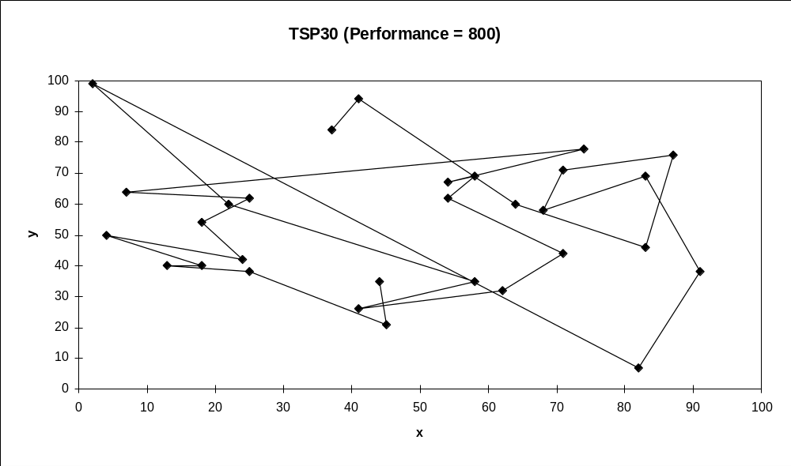
Solution _{j}(Distance = 800)

Slide 26
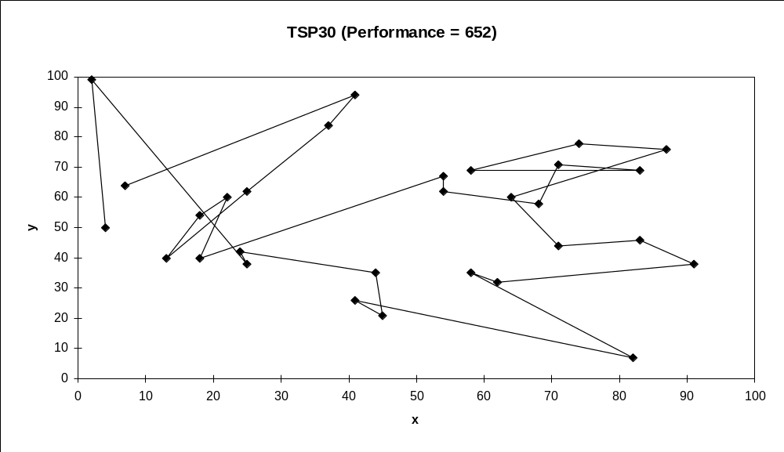
Solution _{k}(Distance = 652)

Slide 27
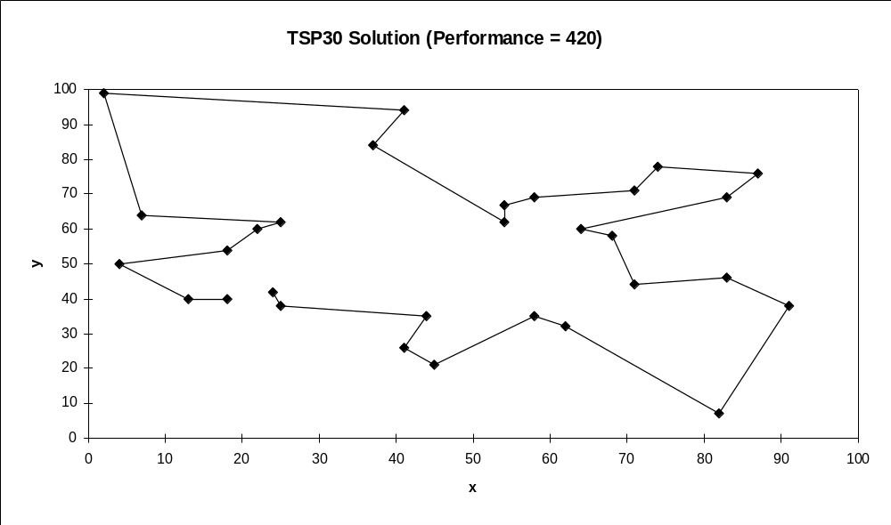
Best Solution (Distance = 420)

Slide 28
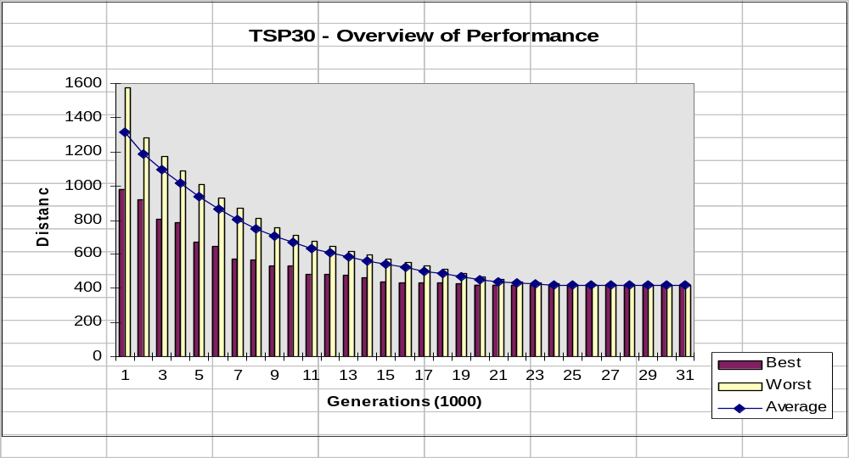
Overview of Performance

Slide 29
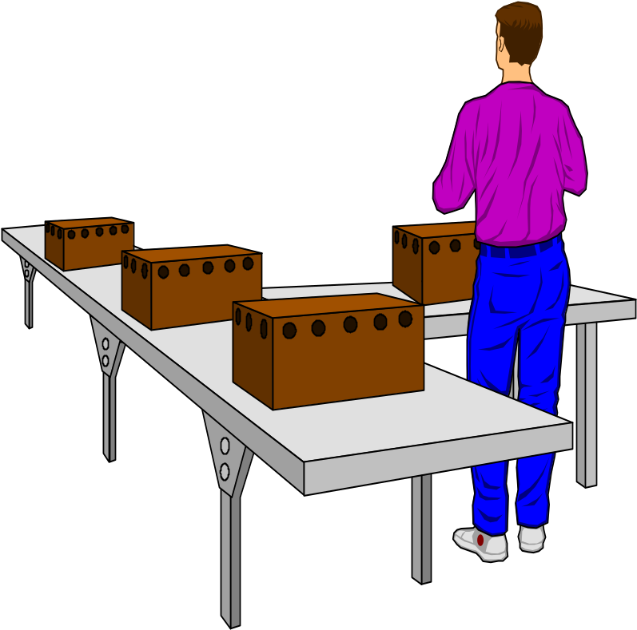
Considering the GA Technology
“Almost eight years ago ... people at Microsoft wrote a program [that] uses some genetic things for finding short code sequences. Windows 2.0 and 3.2, NT, and almost all Microsoft applications products have shipped with pieces of code created by that system.”
- Nathan Myhrvold, Microsoft Advanced Technology Group, Wired, September 1995

Slide 30
Issues for GA Practitioners
Choosing basic implementation issues:
  representation
  population size, mutation rate, ...
  selection, deletion policies
  crossover, mutation operators
Termination Criteria
Performance, scalability
Solution is only as good as the evaluation function (often hardest part)

Slide 31
Benefits of Genetic Algorithms
Concept is easy to understand
Modular, separate from application
Supports multi-objective optimization
Good for “noisy” environments
Always an answer; answer gets better with time
Inherently parallel; easily distributed

Slide 32
Benefits of Genetic Algorithms (cont.)
Many ways to speed up and improve a GA-based application as knowledge about problem domain is gained
Easy to exploit previous or alternate solutions
Flexible building blocks for hybrid applications
Substantial history and range of use

Slide 33
When to Use a GA
Alternate solutions are too slow or overly complicated
Need an exploratory tool to examine new approaches
Problem is similar to one that has already been successfully solved by using a GA
Want to hybridize with an existing solution
Benefits of the GA technology meet key problem requirements

Slide 34
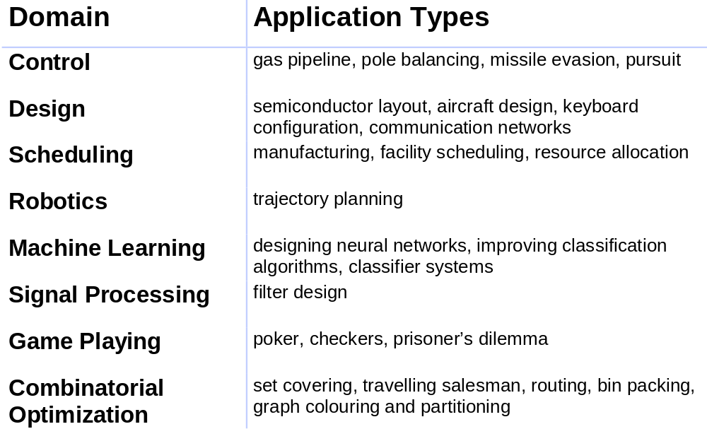
Some GA Application Types

Slide 35
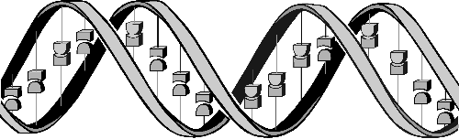
Conclusions
Question: ‘If GAs are so smart, why ain’t they rich?’
Answer: ‘Genetic algorithms are rich - rich in application across a large and growing number of disciplines.’
- David E. Goldberg, Genetic Algorithms in Search, Optimization and Machine Learning

Slide 36
Works Cited
In addition to the inline citations
http://www.macroevolution.net/images/darwin-as-an-old-man-337-450-17.jpg
http://www.genetic-programming.com/c2003lecture1modified.ppt
http://mleg.cse.sc.edu/edu/csce883/uploads/Main.LectureNotes/lec11.ppt

